Slide 1


Slide 2
Chapter 30
Emerging Database Technologies and Applications

Slide 3
Chapter Outline
1 Mobile Databases
2 Multimedia Databases
3 Geographic Information Systems
4 GENOME Data Management

Slide 4
Chapter Outline
1 Mobile Databases
  1.1 Mobile Computing Architecture
  1.2 Characteristics of Mobile Environments
  1.3 Data Management Issues
  1.4 Application: Intermittently Synchronized Databases
2 Multimedia Databases
  2.1 The Nature of Multimedia Data and Applications
  2.2 Data Management Issues
  2.3 Open Research Problems
  2.4 Multimedia Database Applications

Slide 5
Chapter Outline(contd.)
3 Geographic Information Systems
  3.1 GIS Applications
  3.2 Data Management Requirements of GIS
  3.3 Specific GIS Data Operations
  3.4 An Example of GIS Software: ARC-INFO
  3.5 Problems and Future issues in GIS
4 GENOME Data Management
  4.1 Biological Sciences and Genetics
  4.2 Characteristics of Biological Data
  4.3 The Human Genome Project and Existing Biological Database

Slide 6
Emerging Database Technologies and Applications
Emerging database technologies
The major application domains

Slide 7
1 Mobile Databases
Recent advances in portable and wireless technology led to mobile computing, a new dimension in data communication and processing.
Portable computing devices coupled with wireless communications allow clients to access data from virtually anywhere and at any time.
There are a number of hardware and software problems that must be resolved before the capabilities of mobile computing can be fully utilized.
Some of the software problems – which may involve data management, transaction management, and database recovery – have their origins in distributed database systems.

Slide 8
1 Mobile Databases(2)
In mobile computing, the problems are more difficult, mainly:
  The limited and intermittent connectivity afforded by wireless communications.
  The limited life of the power supply(battery).
  The changing topology of the network.
  In addition, mobile computing introduces new architectural possibilities and challenges.

Slide 9
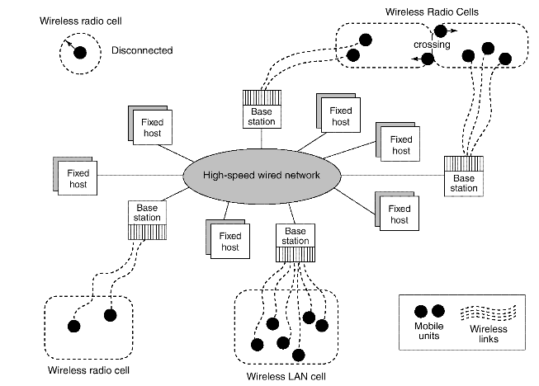
1.1 Mobile Computing Architecture
The general architecture of a mobile platform is illustrated in Fig 30.1.

Slide 10
1.1 Mobile Computing Architecture(2)
It is distributed architecture where a number of computers, generally referred to as Fixed Hosts and Base Stations are interconnected through a high-speed wired network.
  Fixed hosts are general purpose computers configured to manage mobile units.
  Base stations function as gateways to the fixed network for the Mobile Units.

Slide 11
1.1 Mobile Computing Architecture(3)
Wireless Communications –
  The wireless medium have bandwidth significantly lower than those of a wired network.
    The current generation of wireless technology has data rates range from the tens to hundreds of kilobits per second (2G cellular telephony) to tens of megabits per second (wireless Ethernet, popularly known as WiFi).
    Modern (wired) Ethernet, by comparison, provides data rates on the order of hundreds of megabits per second.

Slide 12
1.1 Mobile Computing Architecture(4)
Wireless Communications –
  The other characteristics distinguish wireless connectivity options:
    interference,
    locality of access,
    range,
    support for packet switching,
    seamless roaming throughout a geographical region.

Slide 13
1.1 Mobile Computing Architecture(5)
Wireless Communications –
  Some wireless networks, such as WiFi and Bluetooth, use unlicensed areas of the frequency spectrum, which may cause interference with other appliances, such as cordless telephones.
  Modern wireless networks can transfer data in units called packets, that are used in wired networks in order to conserve bandwidth.

Slide 14
1.1 Mobile Computing Architecture(6)
Client/Network Relationships –
  Mobile units can move freely in a geographic mobility domain, an area that is circumscribed by wireless network coverage.
    To manage entire mobility domain is divided into one or more smaller domains, called cells, each of which is supported by at least one base station.
    Mobile units be unrestricted throughout the cells of domain, while maintaining information access contiguity.

Slide 15
1.1 Mobile Computing Architecture(7)
Client/Network Relationships –
  The communication architecture described earlier is designed to give the mobile unit the impression that it is attached to a fixed network, emulating a traditional client-server architecture.
  Wireless communications, however, make other architectures possible. One alternative is a mobile ad-hoc network (MANET), illustrated in 29.2.

Slide 16
1.1 Mobile Computing Architecture(9)
Client/Network Relationships –
  In a MANET, co-located mobile units do not need to communicate via a fixed network, but instead, form their own using cost-effective technologies such as Bluetooth.
  In a MANET, mobile units are responsible for routing their own data, effectively acting as base stations as well as clients.
    Moreover, they must be robust enough to handle changes in the network topology, such as the arrival or departure of other mobile units.

Slide 17
1.1 Mobile Computing Architecture(10)
Client/Network Relationships –
  MANET applications can be considered as peer-to-peer, meaning that a mobile unit is simultaneously a client and a server.
    Transaction processing and data consistency control become more difficult since there is no central control in this architecture.
    Resource discovery and data routing by mobile units make computing in a MANET even more complicated.
    Sample MANET applications are multi-user games, shared whiteboard, distributed calendars, and battle information sharing.

Slide 18
1.2 Characteristics of Mobile Environments
The characteristics of mobile computing include:
  Communication latency
  Intermittent connectivity
  Limited battery life
  Changing client location

Slide 19
1.2 Characteristics of Mobile Environments(2)
The server may not be able to reach a client.
  A client may be unreachable because it is dozing – in an energy-conserving state in which many subsystems are shut down – or because it is out of range of a base station.
    In either case, neither client nor server can reach the other, and modifications must be made to the architecture in order to compensate for this case.
  Proxies for unreachable components are added to the architecture.
    For a client (and symmetrically for a server), the proxy can cache updates intended for the server.

Slide 20
1.2 Characteristics of Mobile Environments(3)
Mobile computing poses challenges for servers as well as clients.
  The latency involved in wireless communication makes scalability a problem.
    Since latency due to wireless communications increases the time to service each client request, the server can handle fewer clients.
  One way servers relieve this problem is by broadcasting data whenever possible.
  A server can simply broadcast data periodically.
  Broadcast also reduces the load on the server, as clients do not have to maintain active connections to it.

Slide 21
1.2 Characteristics of Mobile Environments(4)
Client mobility also poses many data management challenges.
  Servers must keep track of client locations in order to efficiently route messages to them.
  Client data should be stored in the network location that minimizes the traffic necessary to access it.
  The act of moving between cells must be transparent to the client.
  The server must be able to gracefully divert the shipment of data from one base to another, without the client noticing.
  Client mobility also allows new applications that are location-based.

Slide 22
1.3 Data Management Issues
From a data management standpoint, mobile computing may be considered a variation of distributed computing. Mobile databases can be distributed under two possible scenarios:
  The entire database is distributed mainly among the wired components, possibly with full or partial replication.
    A base station or fixed host manages its own database with a DBMS-like functionality, with additional functionality for locating mobile units and additional query and transaction management features to meet the requirements of mobile environments.
  The database is distributed among wired and wireless components.
    Data management responsibility is shared among base stations or fixed hosts and mobile units.

Slide 23
1.3 Data Management Issues(2)
Data management issues as it is applied to mobile databases:
  Data distribution and replication
  Transactions models
  Query processing
  Recovery and fault tolerance
  Mobile database design
  Location-based service
  Division of labor
  Security

Slide 24
1.4 Application: Intermittently Synchronized Databases
Whenever clients connect – through a process known in industry as synchronization of a client with a server – they receive a batch of updates to be installed on their local database.
  The primary characteristic of this scenario is that the clients are mostly disconnected; the server is not necessarily able reach them.
  This environment has problems similar to those in distributed and client-server databases, and some from mobile databases.
This environment is referred to as Intermittently Synchronized Database Environment (ISDBE).

Slide 25
1.4 Application: Intermittently Synchronized Databases(2)
The characteristics of Intermittently Synchronized Databases (ISDBs) make them distinct from the mobile databases are:
  A client connects to the server when it wants to exchange updates.
    The communication can be unicast –one-on-one communication between the server and the client– or multicast– one sender or server may periodically communicate to a set of receivers or update a group of clients.
  A server cannot connect to a client at will.

Slide 26
1.4 Application: Intermittently Synchronized Databases(3)
The characteristics of ISDBs (contd.) :
  Issues of wireless versus wired client connections and power conservation are generally immaterial.
  A client is free to manage its own data and transactions while it is disconnected. It can also perform its own recovery to some extent.
  A client has multiple ways connecting to a server and, in case of many servers, may choose a particular server to connect to based on proximity, communication nodes available, resources available, etc.

Slide 27
2 Multimedia Databases
In the years ahead multimedia information systems are expected to dominate our daily lives.
  Our houses will be wired for bandwidth to handle interactive multimedia applications.
  Our high-definition TV/computer workstations will have access to a large number of databases, including digital libraries, image and video databases that will distribute vast amounts of multisource multimedia content.

Slide 28
2.1 Multimedia Databases
DBMSs have been constantly adding to the types of data they support.
Today many types of multimedia data are available in current systems.

Slide 29
2.1 Multimedia Databases(2)
Types of multimedia data are available in current systems
  Text: May be formatted or unformatted. For ease of parsing structured documents, standards like SGML and variations such as HTML are being used.
  Graphics: Examples include drawings and illustrations that are encoded using some descriptive standards (e.g. CGM, PICT, postscript).

Slide 30
2.1 Multimedia Databases(3)
Types of multimedia data are available in current systems (contd.)
  Images: Includes drawings, photographs, and so forth, encoded in standard formats such as bitmap, JPEG, and MPEG. Compression is built into JPEG and MPEG.
    These images are not subdivided into components. Hence querying them by content (e.g., find all images containing circles) is nontrivial.
  Animations: Temporal sequences of image or graphic data.

Slide 31
2.1 Multimedia Databases(4)
Types of multimedia data are available in current systems (contd.)
  Video: A set of temporally sequenced photographic data for presentation at specified rates– for example, 30 frames per second.
  Structured audio: A sequence of audio components comprising note, tone, duration, and so forth.

Slide 32
2.1 Multimedia Databases(5)
Types of multimedia data are available in current systems (contd.)
  Audio: Sample data generated from aural recordings in a string of bits in digitized form. Analog recordings are typically converted into digital form before storage.

Slide 33
2.1 Multimedia Databases(6)
Types of multimedia data are available in current systems (contd.)
  Composite or mixed multimedia data: A combination of multimedia data types such as audio and video which may be physically mixed to yield a new storage format or logically mixed while retaining original types and formats. Composite data also contains additional control information describing how the information should be rendered.

Slide 34
2.1 Multimedia Databases(7)
Nature of Multimedia Applications:
  Multimedia data may be stored, delivered, and utilized in many different ways.
  Applications may be categorized based on their data management characteristics.

Slide 35
2.1 Multimedia Databases(8)
Characterization of applications based on their data management characteristics:
  Repository applications: A large amount of multimedia data as well as metadata is stored for retrieval purposes. Examples include repositories of satellite images, engineering drawings and designs, space photographs, and radiology scanned pictures.

Slide 36
2.1 Multimedia Databases(9)
Characterization of applications based on their data management characteristics (contd.):
  Presentation applications: A large amount of applications involve delivery of multimedia data subject to temporal constraints; simple multimedia viewing of video data, for example, requires a system to simulate VCR-like functionality. Complex and interactive multimedia presentations involve orchestration directions to control the retrieval order of components in a series or in parallel. Interactive environments must support capabilities such as real-time editing analysis or annotating of video and audio data.

Slide 37
2.1 Multimedia Databases(10)
Characterization of applications based on their data management characteristics:
  Collaborative work using multimedia information: This is a new category of applications in which engineers may execute a complex design task by merging drawings, fitting subjects to design constraints, and generating new documentation, change notifications, and so forth. Intelligent healthcare networks as well as telemedicine will involve doctors collaborating among themselves, analyzing multimedia patient data and information in real time as it is generated.

Slide 38
2.2 Data Management Issues
Multimedia applications dealing with thousands of images, documents, audio and video segments, and free text data depend critically on
  Appropriate modeling of the structure and content of data
  Designing appropriate database schemas for storing and retrieving multimedia information.

Slide 39
2.2 Data Management Issues(2)
Multimedia information systems are very complex and embrace a large set of issues:
  Modeling
    Complex objects
  Design
    Conceptual, logical, and physical design of multimedia has not been addressed fully.

Slide 40
2.2 Data Management Issues(3)
Multimedia information systems are very complex and embrace a large set of issues (contd.):
  Storage
    Multimedia data on standard disklike devices presents problems of representation, compression, mapping to device hierarchies, archiving, and buffering during the input/output operation.
  Queries and retrieval
    “Database” way of retrieving information is based on query languages and internal index structures.

Slide 41
2.2 Data Management Issues(4)
Multimedia information systems are very complex and embrace a large set of issues (contd.):
  Performance
    Multimedia applications involving only documents and text, performance constraints are subjectively determined by the user.
    Applications involving video playback or audio-video synchronization, physical limitations dominate.

Slide 42
2.3 Multimedia Database Applications
Large-scale applications of multimedia databases can be expected encompasses a large number of disciplines and enhance existing capabilities.
  Documents and records management
  Knowledge dissemination
  Education and training
  Marketing, advertising, retailing, entertainment, and travel
  Real-time control and monitoring

Slide 43
3 Geographic Information Systems
Geographic information systems(GIS) are used to collect, model, and analyze information describing physical properties of the geographical world.

Slide 44
3 Geographic Information Systems(2)
The scope of GIS broadly encompasses two types of data:
  Spatial data, originating from maps, digital images, administrative and political boundaries, roads, transportation networks, physical data, such as rivers, soil characteristics, climatic regions, land elevations, and
  Non-spatial data, such as socio-economic data (like census counts), economic data, and sales or marketing information. GIS is a rapidly developing domain that offers highly innovative approaches to meet some challenging technical demands.

Slide 45
3.1 GIS Applications
It is possible to divide GISs into three categories:
  Cartographic applications
  Digital terrain modeling applications
  Geographic objects applications

Slide 46
3.1 GIS Applications(2)
GIS Applications
Digital Terrain Modeling Applications
Geographic Objects Applications
Cartographic
Irrigation
Car navigation systems
Earth science
Crop yield analysis
Geographic market analysis
Civil engineering and military evaluation
Land Evaluation
Utility distribution and consumption
Soil Surveys
Planning and Facilities management
Air and water pollution studies
Consumer product and services – economic analysis
Landscape studies
Flood Control
Traffic pattern analysis
Water resource management

Slide 47
3.2 Data Management Requirements of GIS
The functional requirements of the GIS applications above translate into the following database requirements.

Slide 48
3.2 Data Management Requirements of GIS (2)
Data Modeling and Representation
GIS data can be broadly represented in two formats:
  Vector data represents geometric objects such as points, lines, and polygons.

Slide 49
3.2 Data Management Requirements of GIS (3)
Data Modeling and Representation (contd.):
  Raster data is characterized as an array of points, where each point represents the value of an attribute for a real-world location.
    Informally, raster images are n-dimensional array where each entry is a unit of the image and represents an attribute. Two-dimensional units are called pixels, while three-dimensional units are called voxels.
    Three-dimensional elevation data is stored in a raster-based digital elevation model (DEM) format.

Slide 50
3.2 Data Management Requirements of GIS (4)
Another raster format called triangular irregular network (TIN) is a topological vector-based approach that models surfaces by connecting sample points as vector of triangles and has a point density that may vary with the roughness of the terrain.
Rectangular grids (or elevation matrices) are two-dimensional array structures.
In digital terrain modeling (DTM), the model also may be used by substituting the elevation with some attribute of interest such as population density or air temperature.
GIS data often includes a temporal structure in addition to a spatial structure.

Slide 51
3.2 Data Management Requirements of GIS (5)
Data Analysis
GIS data undergoes various types of analysis.
  For example, in applications
    such as soil erosion studies, environmental impact studies, or hydrological runoff simulations,
  DTM data may undergo various types of geomorphometric analysis – measurements such as
    slope values, gradients (the rate of change in altitude), aspect (the compass direction of the gradient), profile convexity (the rate of change of gradient), plan convexity (the convexity of contours and other parameters).

Slide 52
3.2 Data Management Requirements of GIS (6)
Data Integration
GISs must integrate both vector and raster data from a variety of sources.
  Sometimes edges and regions are inferred from a raster image to form a vector model, or conversely, raster images such as aerial photographs are used to update vector models.
  Several coordinate systems such as Universal Transverse Mercator (UTM), latitude/longitude, and local cadastral systems are used to identify locations.
  Data originating from different coordinate systems requires appropriate transformations.

Slide 53
3.2 Data Management Requirements of GIS (7)
Data Capture
The first step in developing a spatial database for cartographic modeling is
  to capture the two-dimensional or three-dimensional geographical information in digital form
    This process that is sometimes impeded by source map characteristics such as resolution, type of projection, map scales, cartographic licensing, diversity of measurement techniques, and coordinate system differences.
  Spatial data can also be captured from remote sensors in satellites such as Landsat, NORA, and Advanced Very High Resolution Radiometer(AVHRR) as well as SPOT HRV (High Resolution Visible Range Instrument.

Slide 54
3.3 Specific GIS Data Operations
GIS applications are conducted through the use of special operators such as the following:
  Interpolation
  Interpretation
  Proximity analysis
  Raster image processing
  Analysis of networks

Slide 55
3.3 Specific GIS Data Operations(2)
The functionality of a GIS database is also subject to other considerations:
  Extensibility
  Data quality control
  Visualization
Such requirements clearly illustrate that standard RDBMSs or ODBMSs do not meet the special needs of GIS.
  Therefore it is necessary to design systems that support the vector and raster representations and the spatial functionality as well as the required DBMS features.

Slide 56
4.1 Genome Data Management
Biological Sciences and Genetics:
  The biological sciences encompass an enormous variety of information.
    Environmental science gives us a view of how species live and interact in a world filled with natural phenomena.
    Biology and ecology study particular species.
    Anatomy focuses on the overall structure of an organism, documenting the physical aspects of individual bodies.
    Traditional medicine and physiology break the organism into systems and tissues and strive to collect information on the workings of these systems and the organism as a whole.

Slide 57
4.1 Genome Data Management(2)
Histology and cell biology delve into the tissue and cellular levels and provide knowledge about the inner structure and function of the cell.
  This wealth of information that has been generated, classified, and stored for centuries has only recently become a major application of database technology.

Slide 58
4.1 Genome Data Management(3)
Genetics has emerged as an ideal field for the application of information technology.
  In a broad sense, it can be taught of as the construction of models based on information about genes and population and the seeking out of relationships in that information.
    Genes can be defined as units of heredity

Slide 59
4.1 Genome Data Management(4)
The study of genetics can be divided into three branches:
  Mendelian genetics is the study of the transmission of traits between generations.
  Molecular genetics is the study of the chemical structure and function of genes at the molecular level.
  Population genetics is the study of how genetic information varies across populations of organisms.

Slide 60
4.1 Genome Data Management(5)
The origins of molecular genetics can be traced to two important discoveries:
  In 1869 when Friedrich Miescher discovered nuclein and its primary component, deoxyribonucleic acid (DNA).
    In subsequent research DNA and a related compound, ribonucleic acid, were found to be composed of nucleotides (a sugar, a phosphate, and a base combining to form nucleic acid) linked into long polymers via the sugar and phosphate.
  The second discovery was the demonstration in 1944 by Oswald Avery that DNA was indeed the molecular substance carrying genetic information.

Slide 61
4.1 Genome Data Management(6)
Genes were shown to be composed of chains of nucleic acids arranged linearly on chromosomes and to serve three primary functions:
  Replicating genetic information between generations,
  Providing blueprints for the creation of polypeptides, and
  Accumulating changes– thereby allowing evolution to occur.
Watson and Crick found the double-helix structure of the DNA in 1953, which gave molecular biology a new direction.

Slide 62
4.2 Characteristics of Biological Data
Biological data exhibits many special characteristics that make management of biological information a particularly challenging problem.
The characteristics related to biological information, and focusing on a multidisciplinary field called bioinformatics that has emerged.
  Bioinformatics addresses information management of genetic information with special emphasis on DNA sequence analysis.

Slide 63
4.2 Characteristics of Biological Data(2)
Applications of bioinformatics span design of targets for drugs, study of mutations and related diseases, anthropological investigations on migration patterns of tribes and therapeutic treatments.
  Characteristic 1: Biological data is highly complex when compared with most other domains or applications.
  Characteristic 2: The amount and range of variability in data is high.

Slide 64
4.2 Characteristics of Biological Data(3)
Characteristics of Biological Data (contd.)
  Characteristic 3: Schemas in biological databases change at a rapid pace.
  Characteristic 4: Representations of the same data by different biologists will likely be different (even using the same system).
  Characteristic 5: Most users of biological data do not require write access to the database; read-only access is adequate.

Slide 65
4.2 Characteristics of Biological Data(4)
Characteristics of Biological Data (contd.)
  Characteristic 6: Most biologists are not likely to have knowledge of the internal structure of the database or about schema design.
  Characteristic 7: The context of data gives added meaning for its use in biological applications.

Slide 66
4.2 Characteristics of Biological Data(5)
Characteristics of Biological Data (contd.)
  Characteristic 8: Defining and representing complex queries is extremely important to the biologist.
  Characteristic 9: Users of biological information often require access to “old” values of the data – particularly when verifying previously reported results.

Slide 67
4.3 The Human Genome Project and Existing Biological Databases
The term genome is defined as the total genetic information that can be obtained about an entity.
  E.g., the human genome generally refers to the complete set of genes required to create a human being
    The number is estimated to be more than 30,000 genes spread over 23 pairs of chromosomes, with an estimated 3 to 4 billion nucleotides.
  The goal of the Human Genome Project (HGP) has been to obtain the complete sequence – the ordering of the bases – of those nucleotides.

Slide 68
4.3 The Human Genome Project and Existing Biological Databases(2)
Some of the existing database systems that are supporting or have grown out of the Human Genome Project.
GenBank
  The preeminent DNA sequence database in the world today is GenBank, maintained by the National Center for Biotechnology Information (NCBI) of the National Library of Medicine (NLM).

Slide 69
4.3 The Human Genome Project and Existing Biological Databases(3)
GenBank (contd.)
  Established in 1978 as a repository for DNA sequence data.
  Since 1978 expanded to include sequence tag data, protein sequence data, three-dimensional protein structure, taxonomy, and links to the medical literature (MEDLINE).

Slide 70
4.3 The Human Genome Project and Existing Biological Databases(4)
GenBank (contd.)
  As of release 135.0 in April 2003, GenBank contains over 31 billion nucleotide bases of more than 24 million sequences from over 100,000 species with roughly 1400 new organisms being added each month.
  The database size in flat file format is over 100 GB uncompressed and has been doubling every 15 months.

Slide 71
4.3 The Human Genome Project and Existing Biological Databases(5)
GenBank (contd.)
  International collaboration with the European Molecular Biology Laboratory (EMBL) in the U.K. and the DNA Data Bank of Japan (DDBJ) on daily basis.
  Other limited data sources (e.g. three-dimensional structure and Online Mendelian Inheritance in Man (OMIM), have been added recently by reformatting the existing OMIM and PDB databases and redesigning the structure of the GenBank system to accommodate these new data sets.

Slide 72
4.3 The Human Genome Project and Existing Biological Databases(6)
GenBank (contd.)
  The system is maintained as a combination of flat files, relational databases, and files containing Abstract Syntax Notation One (ASN.1)

Slide 73
4.3 The Human Genome Project and Existing Biological Databases(7)
GenBank (contd.)
  The average user of the database is not able to access the structure of the data directly for querying or other functions, although complete snapshots of the database are available for export in a number of formats, including ASN.1. The query mechanism provided is via the Entrez application (or its www version), which allows keyword, sequence, and GenBank UID searching through a static interface.

Slide 74
4.3 The Human Genome Project and Existing Biological Databases(8)
The Genome Database (GDB)
  Created in 1989, GDB is a catalog of human gene mapping data, a process that associates a piece of information with a particular location on the human genome.
  GDB data includes data describing primarily map information (distance and confidence limits), and Polymerase Chain Reaction (PCR) probe data (experimental conditions, PCR primers, and reagents used).

Slide 75
4.3 The Human Genome Project and Existing Biological Databases(9)
The Genome Database (GDB) (contd.)
  More recently efforts have been made to add data on mutations linked to genetic loci, cell lines used in experiments, DNA probe libraries, and some limited polymorphism and population data.
  The GDB system is built around Sybase, a commercial relational DBMS, and its data are modeled using standard Entity-Relationship techniques.
    GDB distributes a Database Access Toolkit

Slide 76
4.3 The Human Genome Project and Existing Biological Databases(10)
The Genome Database (GDB) (contd.)
  As with GenBank, users are given only a very high-level view of the data at the time of searching and thus cannot make use of any knowledge gleaned from the structure of the GDB tables.
    Search methods are most useful when users are simply looking for an index into map or probe data.
    Exploratory ad hoc searching is not encouraged by present interfaces.
    Integration of the database structures of GDB and OMIM was never fully established.

Slide 77
4.3 The Human Genome Project and Existing Biological Databases(11)
Online Mendelian Inheritance in Man
  Online Mandelian Inheritance in Man (OMIM) is an electronic compendium of information on the genetic basis of human disease.
  Begun in hard-copy form by Victor McCusick in 1966 with 1500 entries, it was converted to a full-text electronic form between 1987 and 1989 by GDB.
    In 1991 its administration was transferred from John Hopkins University to the NCBI, and the entire database was converted to NCBI’s GenBank format. Today it contains more than 14,000 entries.

Slide 78
4.3 The Human Genome Project and Existing Biological Databases(12)
Online Mendelian Inheritance in Man (contd.)
  OMIM covers material on five disease areas based loosely on organs and systems.
    Any morphological, biochemical, behavioral, or other properties under study are referred to as phenotype of an individual (or a cell).
    Mendel realized that genes can exist in numerous forms known as alleles.
    A genotype refers to the actual allelic composition of an individual.

Slide 79
4.3 The Human Genome Project and Existing Biological Databases(13)
EcoCyc
  The Encyclopedia of Escherichia coli Genes and Metabolism (EcoCyc) is a recent experiment in combining information about the genome and the metabolism of E.coli K-12.
  The database was created in 1996 as a collaboration between Stanford Research Institute and Marine Biological Laboratory.

Slide 80
4.3 The Human Genome Project and Existing Biological Databases(14)
EcoCyc (contd.)
  An object-oriented data model was first used to implement the system, with data stored in Ocelot, a frame knowledge representation system. EcoCyc data was arranged in a hierarchy of object classes based on observations that
    the properties of a reaction are independent of an enzyme that catalyzes it, and
    an enzyme has a number of properties that are “logically distinct” from its reactions.

Slide 81
4.3 The Human Genome Project and Existing Biological Databases(15)
EcoCyc (contd.)
  EcoCyc provides two methods of querying:
    direct (via predefined queries) and
    indirect (via hypertext navigation).

Slide 82
4.3 The Human Genome Project and Existing Biological Databases(16)
Gene Ontology
  Gene Ontology (GO) Consortium was formed in 1998 as a collaboration among three model organism databases: FlyBase, Mouse Genome Informatics (MGI) and Saccharomyces or yeast Genome Database (SGD).
    The goal is to produce a structured, precisely defined, common, controlled vocabulary for describing the roles of genes and gene products in any organism.

Slide 83
4.3 The Human Genome Project and Existing Biological Databases(17)
Gene Ontology (contd.)
  With the completion of genome sequencing of many species, it has been observed that a large fraction of genes among organisms display similarity in biological roles and biologists have acknowledge that there is likely to be a single limited universe of genes and proteins that are conserved in most or all living cells.
  The GO Consortium has developed three ontologies: Molecular function, biological process, and cellular component, to describe attributes of genes, gene products, or gene product groups.

Slide 84
4.3 The Human Genome Project and Existing Biological Databases(18)
Gene Ontology (contd.)
  Each ontology comprises a set of well-defined vocabularies of terms and relationships.
    The terms are organized in the form of directed acyclic graphs (DAGs), in which a term node may have multiple parents and multiple children.
    A child term can be an instance of (is a) or part of its parent.
    Latest release of GO database has over 13,000 terms and more than 18,000 relationships between terms.
    GO was implemented using MySQL, an open source relational database and a monthly database release is available in SQL and XML formats.

Slide 85
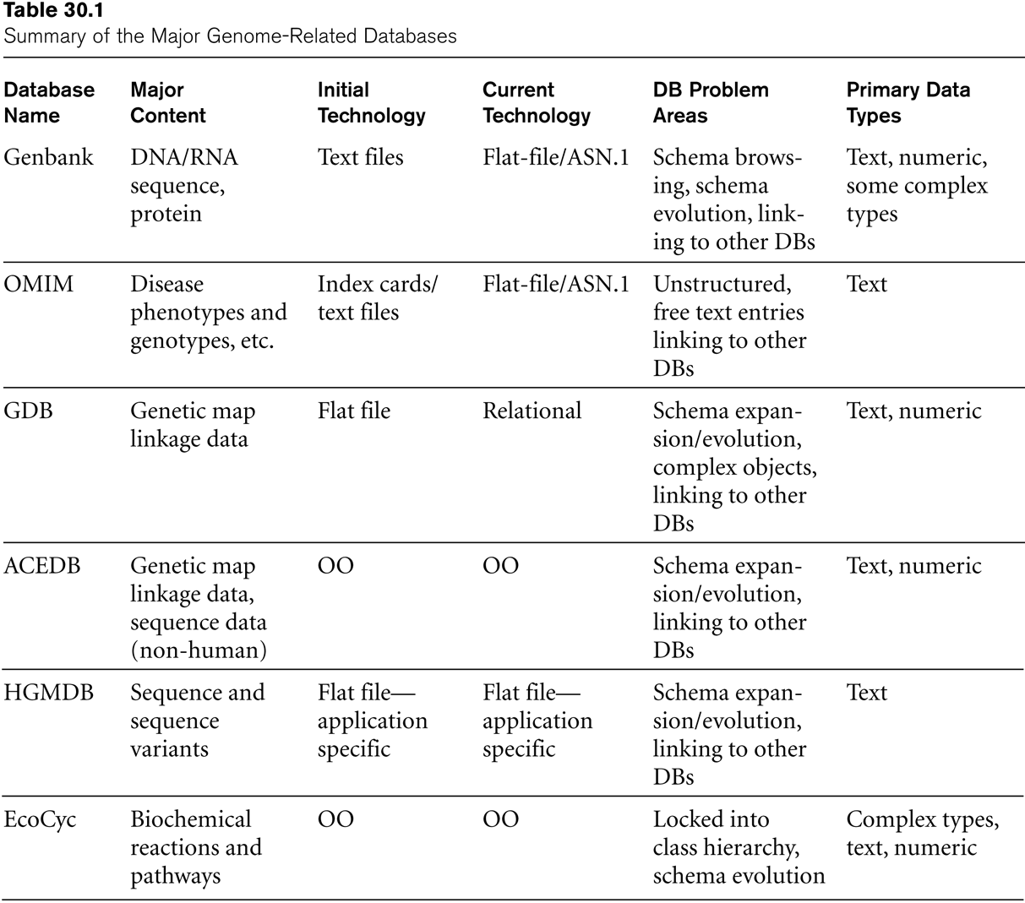
Summary Of the Major Genome-Related Databases

Slide 86
Recap
1 Mobile Databases
  1.1 Mobile Computing Architecture
  1.2 Characteristics of Mobile Environments
  1.3 Data Management Issues
  1.4 Application: Intermittently Synchronized Databases
2 Multimedia Databases
  2.1 The Nature of Multimedia Data and Applications
  2.2 Data Management Issues
  2.3 Open Research Problems
  2.4 Multimedia Database Applications

Slide 87
Recap
3 Geographic Information Systems
  3.1 GIS Applications
  3.2 Data Management Requirements of GIS
  3.3 Specific GIS Data Operations
  3.4 An Example of GIS Software: ARC-INFO
  3.5 Problems and Future issues in GIS
4 GENOME Data Management
  4.1 Biological Sciences and Genetics
  4.2 Characteristics of Biological Data
  4.3 The Human Genome Project and Existing Biological Database

